Slide 1
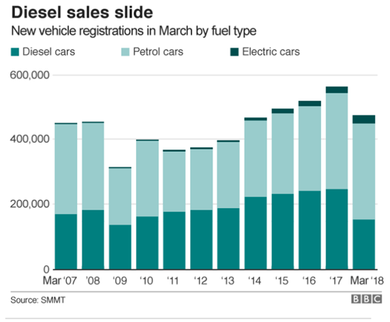
Visualisation and Presenting Data
Tables?
Graphical representation?
Frequency distributions?
Newspapers, magazines and television all use these types of displays to try and convey information in an easy to assimilate way.
In a nut shell what these forms of displays aim to do is to summarise large sets of raw data such that we can see at a glance the 'behaviour' of the data.

Slide 2
Learning Objectives
On successful completion of the module, you will be able to:
Understand the different types of data variables that can be used to represent a specific measurement.
Know how to present data in table form.
Present data in a variety of graphical forms.
Construct frequency distributions from raw data.
Distinguish between discrete and continuous data.
Construct histograms for equal class widths.
Solve problems using Microsoft Excel and IBM SPSS Statistics

Slide 3
Introduction
In statistics we have two distinct types:
Descriptive Statistics – comprises collecting, presenting data (tables and graphs) and describing data (central tendency, dispersion, skewness, kurtosis). These topics are covered in Chapters 1 and 2.
Inferential Statistics – drawing conclusions about a population value based upon sample data (point and interval estimates, hypothesis testing, fitting lines to data sets (X, Y) using least squares regression, and analysing time series data). This series of topics are covered in Chapters 3 – 10.

Slide 4
Summary of Presenting Data
Presenting Data
Categorical Data
Numerical Data
Tabulating data
Graphing data
Frequency distributions
Tables
Bar charts
Pie charts
Histograms
Polygons
Cumulative distributions
Cumulative frequency graphs (or Ogive)
Bivariate data
Scatter plots
Time series plots

Slide 5
The Different Types of Data Variable
Variable - A variable is any measured characteristic or attribute that differs for different subjects e.g. height of a building, eye colour.
Qualitative (or categorical) – Descriptive variable measuring a particular characteristic (e.g. eye colour) or the variable can be ranked (e.g. finished first, fourth etc)
Quantitative – A numerical variable measured on two scales (interval/ratio)
Nominal – Assigning items to categories e.g. number of people with blue eyes. Frequency distributions are usually used to tabulate and analyse problems involving nominal data.
Ordinal – A set of data is said to be ordinal if the values belonging to it can be ranked
Interval - An interval scale is a scale of measurement where the distance between any two adjacent units of measurement (or ‘intervals’) is the same but the zero point is arbitrary
Ratio - Ratio data are continuous data where both differences and ratios are interpretable and have a natural zero

Slide 6
Recognising a measure scale
Measurement Scale | Recognising a measure scale
Nominal data | Classification data e.g. male or female, red or black car. Arbitrary labels e.g. m or f, r or b, 0 or 1. No ordering e.g. it makes no sense to state that r > b.
Ordinal data | Ordered list e.g. student satisfaction scale of 1, 2, 3, 4, and 5. Differences between values are not important e.g. political parties can be given labels: far left, left, mid, right, far right etc and student satisfaction scale of 1, 2, 3, 4, and 5.
Interval data | Ordered, constant scale, with no natural zero e.g. temperature, dates. Differences make sense, but ratios do not e.g. temperature difference
Ratio data | Ordered, constant scale, and a natural zero e.g. length, height, weight, and age.

Slide 7
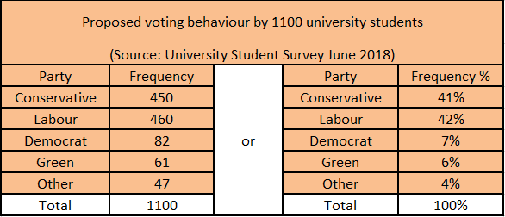
Tables
Tables come in a variety of formats, from simple tables to frequency distribution, that allow data sets to be summarised in a form that allows users to be able to access important information.
Example 1.1
Simple table illustrating the voting intentions of 1110 students

Slide 8
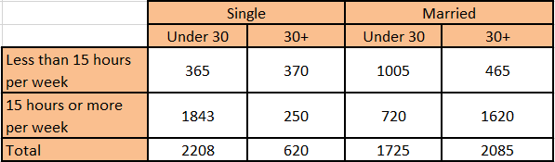
Simple tables
Half-yearly sales of XBAR Ltd.
Month | January | February | March | April | May | June | Total
Pink | 5200 | 4100 | 6000 | 6900 | 6050 | 7000 | 35250
Blue | 2100 | 1050 | 2950 | 5000 | 6300 | 5200 | 22600
Total | 7300 | 5150 | 8950 | 11900 | 12350 | 12200 | 57850
Example 1.2 Half yearly sales of XYonline Ltd
Example 1.3 Viewing habits of adult males

Slide 9
Frequency distributions
Consider the set of data that represents the number of insurance claims processed each day by an insurance firm over a period of 40 days: 3, 5, 9, 6, 4, 7, 8, 6, 2, 5, 10, 1, 6, 3, 6, 5, 4, 7, 8, 4, 5, 9, 4, 2, 7, 6, 1, 3, 5, 6, 2, 6, 4, 8, 3, 1, 7, 9, 7, 2.
SCORE | TALLY | FREQUENCY, f
1 | 111 | 3
2 | 1111 | 4
3 | 1111 | 4
4 | 1111 | 5
5 | 1111 | 5
6 | 1111 11 | 7
7 | 1111 | 5
8 | 111 | 3
9 | 111 | 3
10 | 1 | 1
 |  | Σf = 40
Example 1.4
Frequency distribution

Slide 10
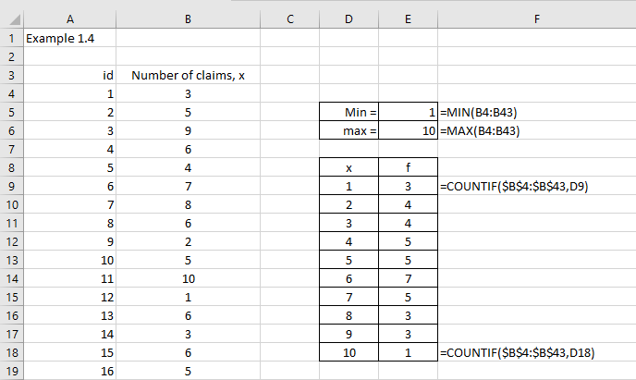
Excel solution
Figure 1.4 illustrates the first 16 values in Cells B4:B43

Slide 11
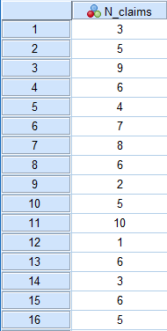
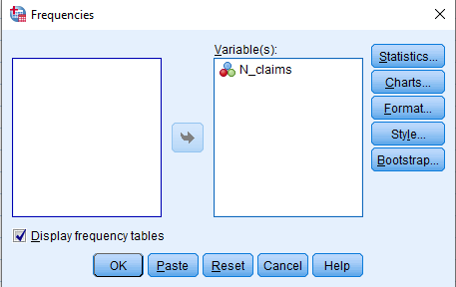
SPSS solution
Input data into SPSS
Figure 1.5 illustrates the first 16 values
Select Analyze > Descriptive Statistics > Frequencies
Transfer N_claims to the Variables(s) box
Figure 1.5
Click OK

Slide 12
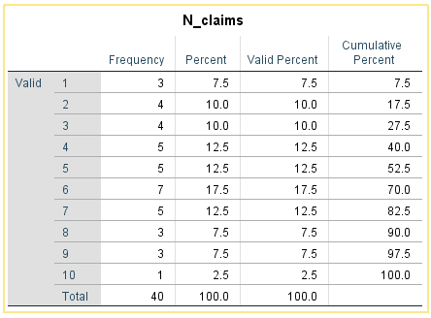
SPSS output solution

Slide 13
Grouped Frequency Distributions
Consider the following data set of miles travelled by 98 trucks in one week.
403 | 407 | 407 | 408 | 410 | 412 | 413 | 413
423 | 424 | 424 | 425 | 426 | 428 | 430 | 430
435 | 435 | 436 | 436 | 436 | 438 | 438 | 438
444 | 444 | 445 | 446 | 447 | 447 | 447 | 448
452 | 453 | 453 | 453 | 454 | 455 | 455 | 456
462 | 462 | 462 | 463 | 464 | 465 | 466 | 468
474 | 474 | 475 | 476 | 477 | 478 | 479 | 481
490 | 493 | 494 | 495 | 497 | 498 | 498 | 500
415 | 430 | 439 | 449 | 457 | 468 | 482 | 502
416 | 431 | 440 | 450 | 457 | 469 | 482 | 502
418 | 432 | 440 | 450 | 458 | 470 | 483 | 505
419 | 432 | 441 | 451 | 459 | 471 | 485 | 508
420 | 433 | 442 | 451 | 459 | 471 | 486 | 509
421 | 433 | 442 | 451 | 460 | 472 | 488 | 511
421 | 434 | 443 | 452 | 460 | 473 | 489 | 515
Example 1.5 Data set

Slide 14
Class Intervals and Boundaries
Data can exist in two forms: discrete and continuous:
Discrete data occurs as an integer (whole number) e.g. 1, 2, 3, 4, 5, 6,.......etc.
Continuous data occurs as a continuous number and can take any level of accuracy, e.g. the number of miles travelled could be 440.3 or 440.34 … etc
MATHEMATICAL LIMIT
STATED LIMIT |  | DISCRETE | CONTINUOUS
A | 5 - under 10 10 - under 15 | 5 - 9 10 - 14 | 5 - 9.999999' 10 - 14.999999'
B | 5 - 9 10 – 15 | 5 - 9 10 - 15 | 4.5 - 9.5 9.5 - 15.5
Normally, we would look at creating 5 – 12 classes in the grouped frequency distribution, where class width = Upper – Lower Class Boundaries.

Slide 15
Counting frequencies
MILEAGE | TALLY | FREQUENCY f
400 - 419 | 1111 1111 11 | 12
420 - 439 | 1111 1111 1111 1111 1111 11 | 27
440 - 459 | 1111 1111 1111 1111 1111 1111 1111 | 34
460 - 479 | 1111 1111 1111 1111 1111 | 24
480 - 499 | 1111 1111 1111 | 15
500 - 519 | 1111 111 | 8
 |  | Σf = 120
Example 1.5 Grouped frequency distribution
See text for the Excel solution

Slide 16
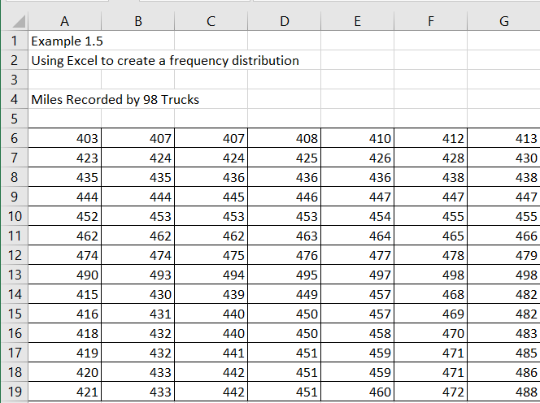
Excel solution
Step 1 Input data into cells A6:G19
Step 2 Use Excel Analysis ToolPak solution to create a frequency distribution
Let us choose the following groups with the bin range calculated from these group values.
Mileage | LCB – UCB | Class width | Bin range
 |  |  | 399.5
400 – 419 | 399.5 – 419.5 | 20 | 419.5
420 – 439 | 419.5 – 439.5 | 20 | 439.5
440 – 459 | 439.5 – 459.5 | 20 | 459.5
460 – 479 | 459.5 – 479.5 | 20 | 479.5
480 – 499 | 479.5 – 499.5 | 20 | 499.5
Table 1.9 Class and bin range
We can see that the class widths are all equal and the corresponding Bin Range is 399.5, 405.5, ……., 499.5.
Figure 1.9

Slide 17
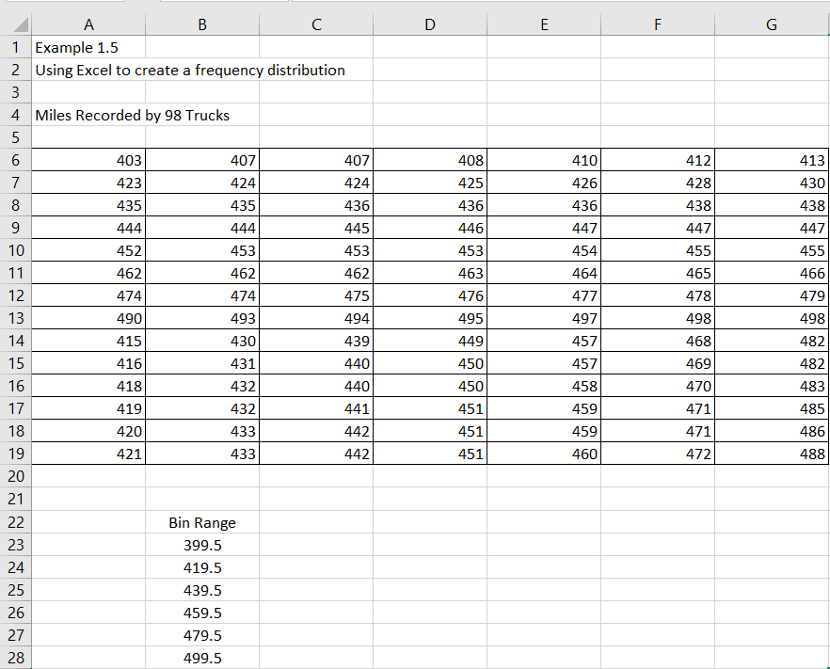
Excel solution continued
We can now use Excel to calculate the grouped frequency distribution. Bin Range: Cells B23:B28 (with the label in cell B22) as illustrated in Figure 1.10.

Slide 18
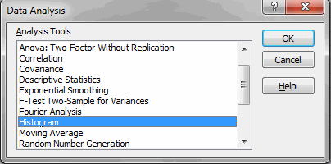
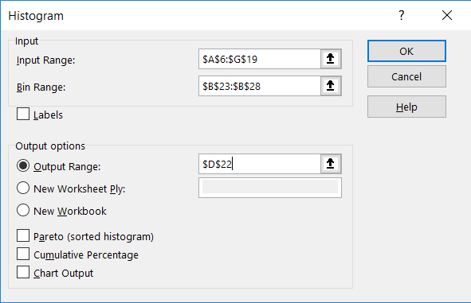
Excel solution continued
Now create the histogram.
Select Data
Select Data Analysis menu
Click on Histogram
Click OK
Excel will now print out the grouped frequency table (Bin Range and frequency of occurrence) as presented in cells D22 – E29.

Slide 19
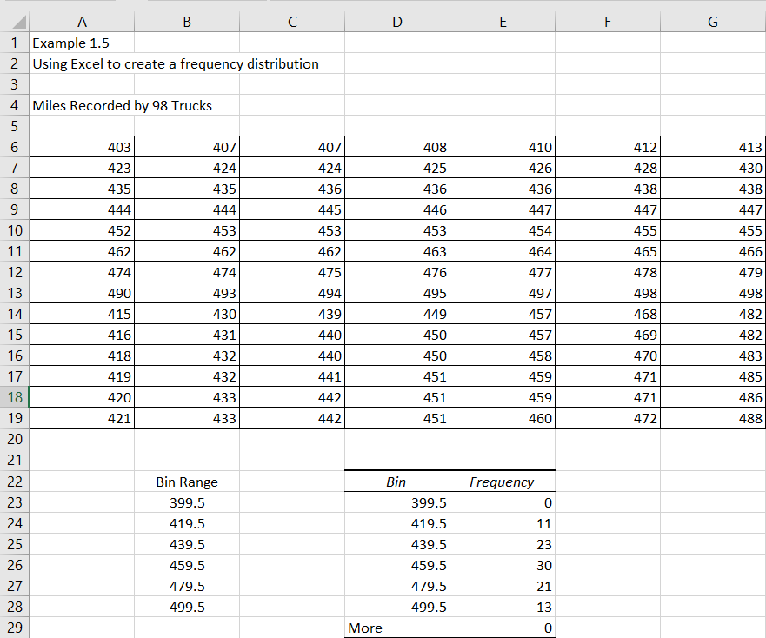
Excel solution continued
The grouped frequency distribution would now be
Bin range | Frequency
399.5 | 0
419.5 | 11
439.5 | 23
459.5 | 30
479.5 | 21
499.5 | 13
More | 0
From this table we can now create the grouped frequency distribution
Bin range | Frequency | Mileage
419.5 | 11 | 400 – 419
439.5 | 23 | 420 – 439
459.5 | 30 | 440 – 459
479.5 | 21 | 460 – 479
499.5 | 13 | 480 – 499
Figure 1.13

Slide 20
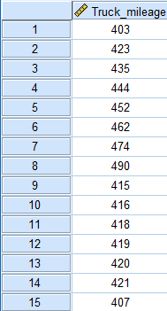
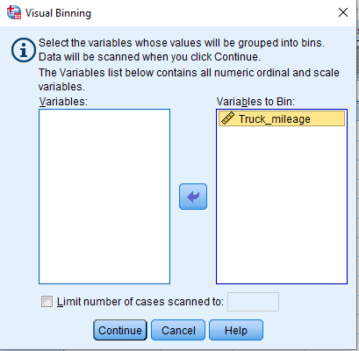
SPSS solution
Input data into SPSS - the first 16 values are illustrated in Figure 1.14
Transform data using Visual Binning
Select Transform > Visual Binning
Transfer Truck_mileage into the Variables to Bin box

Slide 21
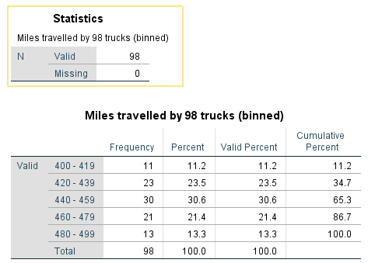
SPSS output solution
The SPSS solution is as illustrated
Please note full instructions are given in the textbook

Slide 22
Graphical Representation of Data
The next stage of analysis after the data has been tabulated is to graph the data using a variety of methods to provide a suitable graph. In this section we will explore:
Bar charts
Pie charts
Histograms
Scatter plots
Time series plots
The type of graph you will use to graph the data depends upon the type of variable you are dealing with within your data set e.g. category (or nominal), ordinal, or interval (or ratio) data as follows:
Data type | Which graph to use?
Category or nominal | Bar chart, pie chart, cross tab tables (or contingency tables)
Ordinal | Bar chart, pie chart, scatter plots.
Interval or ratio | Histogram, frequency polygon, histogram. Cumulative frequency curve (or ogive), scatter plots, time series plots.

Slide 23
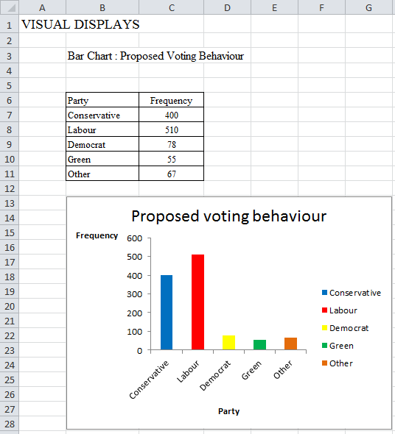
Bar charts
Categorical data is represented largely by bar and pie charts. Bar charts are very useful in providing a simple pictorial representation of several sets of data on one graph.
Example 1.7
Bar chart for proposed voting behaviour
See text for the Excel and SPSS solutions

Slide 24
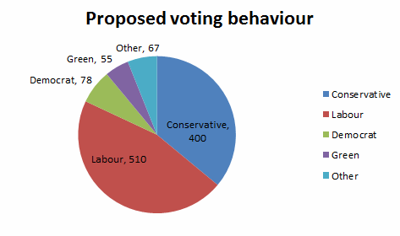
Pie charts
In a pie chart the relative frequencies are represented by a slice of a circle. Each section represents a category, and the area of a section represents the frequency or number of objects within a category.
They are particularly useful in showing relative proportions, but their effectiveness tends to diminish for more than eight categories.
Example 1.11
Pie chart for proposed voting behaviour
See text for the Excel and SPSS solutions

Slide 25
Pie chart – calculating the angles
A set of instructions is provided below if you would like to calculate the angles of each slice in the circle that represents each voting category.
Political party | Voting behaviour | Angle calculation | Angle (degrees) (1 decimal place)
Conservative | 450 | (360/1110)*450 | 147.3
Labour | 460 | (360/1110)*460 | 150.5
Democrat | 82 | (360/1110)*82 | 26.8
Green | 61 | (360/1110)*61 | 20.0
Other | 47 | (360/1110)*47 | 15.4
Total = | 1110 |  | 360
Table 1.17

Slide 26
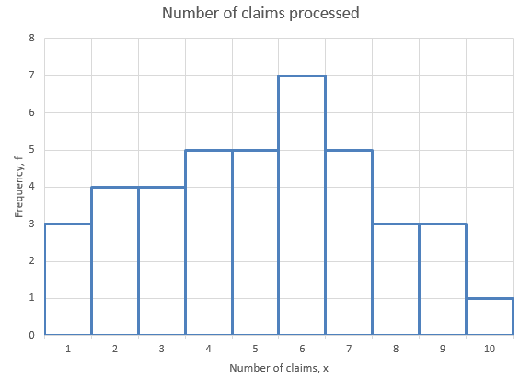
Histograms
A graph of the data in a frequency distribution is called a histogram. The area of each bar is a measure of the frequency of occurrence (number of values) within each category. If the bar widths are the same (constant) then the height of the bar is directly related to the frequency and this information can then be used to construct the histogram.
Example 1.13
Histogram for the number of insurance claims processed

Slide 27
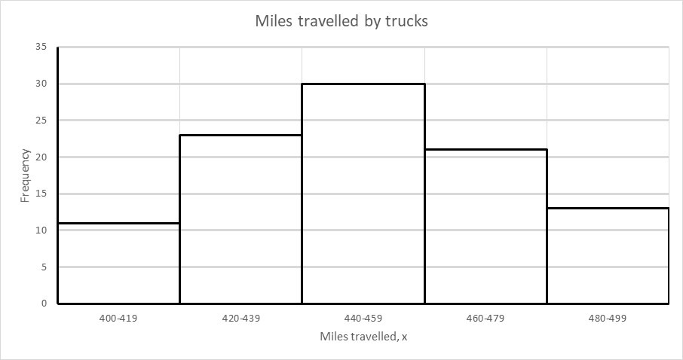
Histogram Example
Example 1.14
Histogram for the miles recorded for 98 trucks
See text for the Excel and SPSS solutions

Slide 28
Creating Scatter Plots
A scatter plot is a graph which helps us assess visually the form of relationship between two variables.
Employee number | Hours worked, X | Profitability, Y
1 | 46 | 4.1
2 | 69 | 7.9
3 | 62 | 6.6
4 | 34 | 4.2
5 | 42 | 4.9
6 | 58 | 7.3
7 | 37 | 4.6
8 | 57 | 5.7
9 | 65 | 6.7
10 | 54 | 5.5
11 | 65 | 5.5
12 | 55 | 5.2
13 | 67 | 7.3
14 | 37 | 3.7
15 | 52 | 5.7
16 | 74 | 6.1
17 | 51 | 5.5
18 | 39 | 3.9
19 | 46 | 5.0
20 | 22 | 2.1
Example 1.15
A manufacturing firm has designed a training program that is supposed to improve individual profitability per employee.
The personal manager decides to examine this claim by analysing the data results from the first group of 20 employees that attended the course. The results are provided in Table 1.28.

Slide 29
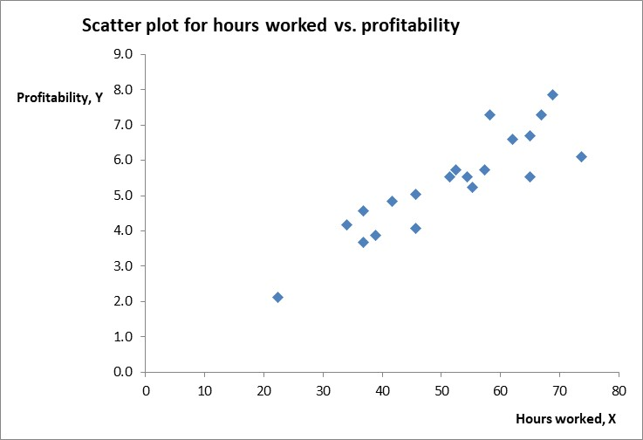
Scatter plots
Scatter plot for hours worked versus profitability
See text for the Excel and SPSS solutions

Slide 30
Time series
Time series analysis is concerned with data collected over a period of time. It attempts to isolate and evaluate various factors which contribute to changes over time in such variable series as imports and exports, sales, unemployment and prices. If we can evaluate the main components which determine the value of say sales for a particular month then we can project the series into the future to obtain a forecast.
Example 1.16
Sales of Pip Ltd 2015-2018 (000 kg)
Year | Quarter 1 | Quarter 2 | Quarter 3 | Quarter 4
2015 | 8502 | 9828 | 10959 | 12571
2016 | 8060 | 9074 | 10387 | 11388
2017 | 9074 | 9724 | 11128 | 12480
2018 | 9399 | 10426 | 11557 | 12688

Slide 31
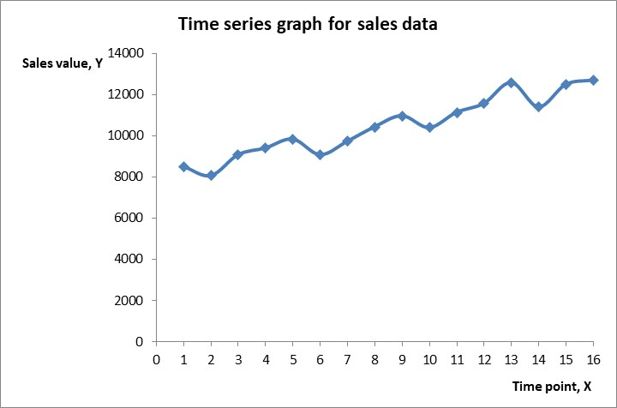
Time series plots
Time series plot for quarterly sales of Pip Ltd
See text for the Excel and SPSS solutions

Slide 32
Conclusion
In this presentation we explored summarising data sets using the following three concepts:
Tables
Frequency distributions
Graphing data

